Slide 1
ETL Process in Data Warehouse

Slide 2
Outline
ETL
Extraction
Transformation
Loading

Slide 3
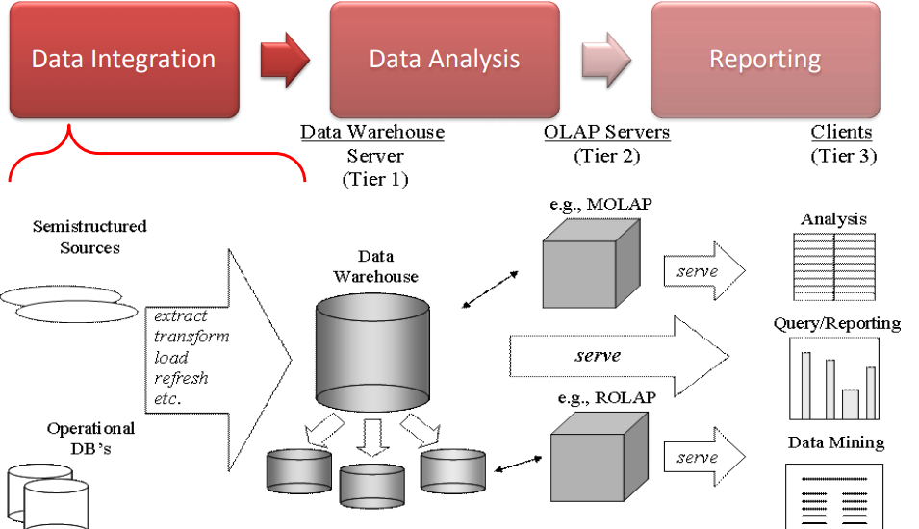
BI Application:

Slide 4
The ETL Process
• The most underestimated process in DW development
• The most time-consuming process in DW development
80% of development time is spent on ETL!
Extract
Extract relevant data
• Transform
Transform data to DW format
Build keys, etc.
Cleansing of data
• Load
Load data into DW
Build aggregates, etc.

Slide 5
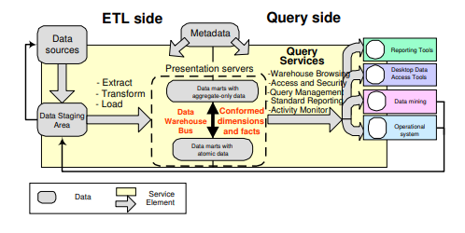
ETL Architecture

Slide 6
Data Staging Area (DSA)
Transit storage for data in the ETL process
Transformations/cleansing done here
No user queries
Sequential operations on large data volumes
Performed by central ETL logic
No need for locking, logging, etc.
RDBMS or flat files? (DBMS have become better at this)
Finished dimensions copied from DSA to releva/nt marts

Slide 7
Plan
1) Make high-level diagram of source-destination flow
2) Test, choose and implement ETL tool
3) Outline complex transformations, key generation and job sequence for every destination table Construction of dimensions
4) Construct and test building static dimension 5) Construct and test change mechanisms for one dimension
6) Construct and test remaining dimension builds Construction of fact tables and automation

Slide 8
7) Construct and test initial fact table build 8) Construct and test incremental update 9) Construct and test aggregate build
10) Design, construct, and test ETL automation

Slide 9
Building Dimensions
Static dimension table
DW key assignment: production keys to DW keys using table
Combination of data sources: find common key?
Check one-one and one-many relationships using sorting
• Handling dimension changes
Find the newest DW key for a given production key Table for mapping production keys to DW keys must be updated

Slide 10
• Load of dimensions
Small dimensions: replace
Large dimensions: load only changes

Slide 11
Two types of load
• Initial load
ETL for all data up till now
Done when DW is started the first time
Very heavy - large data volumes
• Incremental update
Move only changes since last load
Done periodically (e.g., month or week) after DW start
Less heavy - smaller data volumes
Dimensions must be updated before facts
The relevant dimension rows for new facts must be in place
Special key considerations if initial load must be performed again

Slide 12
ETL Overview
Extraction Transformation Loading – ETL
To get data out of the source and load it into the data warehouse – simply a process of copying data from one database to other
Data is extracted from an OLTP database, transformed to match the data warehouse schema and loaded into the data warehouse database
Many data warehouses also incorporate data from non-OLTP systems such as text files, legacy systems, and spreadsheets; such data also requires extraction, transformation, and loading
When defining ETL for a data warehouse, it is important to think of ETL as a process, not a physical implementation

Slide 13
ETL Overview
It is not a one time event as new data is added to the Data Warehouse periodically – monthly, daily, hourly
Because ETL is an integral, ongoing, and recurring part of a data warehouse
Automated
Well documented
Easily changeable

Slide 14
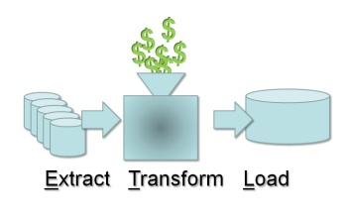

Slide 15
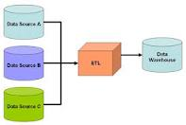
Data Transfer from source to data warehouse
OLAP Server
User

Slide 16
ETL Staging Database
ETL operations should be performed on a relational database server separate from the source databases and the data warehouse database
Creates a logical and physical separation between the source systems and the data warehouse
Minimizes the impact of the intense periodic ETL activity on source and data warehouse databases

Slide 17
Challenges in ETL process
Source Systems are very diverse and disparate
Source system runs on multiple platforms and different operating systems.
Structure of the source system keep changing over time with new technology.
The data type , naming convention may be different in different source systems.
Data in source system is stored in cryptic form which hardly provides any help to the users.
Inconsistency in source system .
Quality of data in not guaranteed in older operational source system.

Slide 18
Major steps in ETL process
ETL for fact tables
ETL for dimension tables
Write procedures for all data loads
Organizing data staging area and test tools
Plan for aggregate tables
Determine data transformation and cleaning rules.
Establish comprehensive data extraction rules.
Prepare data mapping for target data elements from sources
Determine all the data source, both internal and external
Determine all the target data needed in the data warehouse

Slide 19
Types of activities and tasks that compose the ETLprocess
Split one source data structure into several structures to go into several rows of the target database.
Read data from data dictionaries and catalogs of source systems.
Read data from a variety of file structures including flat files, indexed files (VSAM), and legacy system databases (hierarchical/network).
Load details for populating atomic fact tables.
Aggregate for populating aggregate or summary fact tables.
Transform data from one format in the source platform to another format in the target platform.
Derive target values for input fields (example: age from date of birth).
Change cryptic values to values meaningful to the users (example: 1 and 2 to male and female).

Slide 20
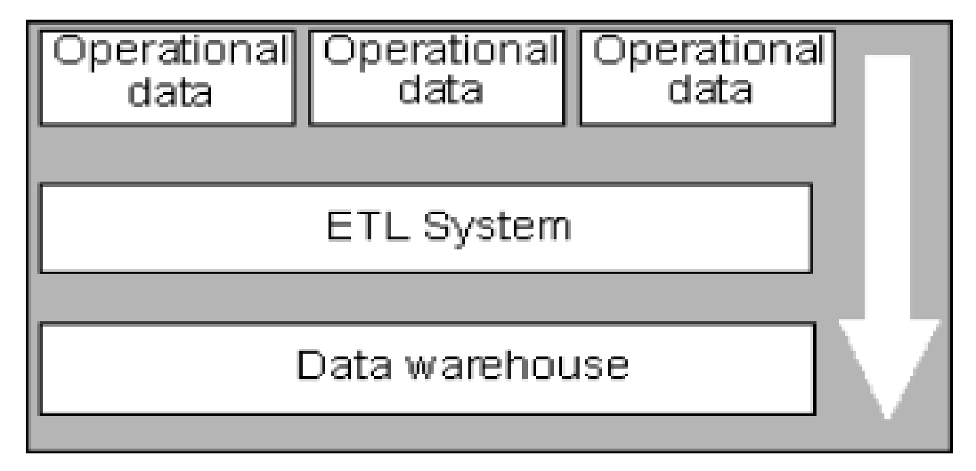
Extraction
The integration of all of the disparate systems across the enterprise is the real challenge to getting the data warehouse to a state where it is usable
Data is extracted from heterogeneous data sources
Each data source has its distinct set of characteristics that need to be managed and integrated into the ETL system in order to effectively extract data.

Slide 21
Extraction
Data extraction issues :
Source Identification- Identify source applications and source structures.
Method of Extraction : - For each data source , define whether the extraction process is manual or tool-based.
Extraction Frequency : - for each data source , establish how frequency the data extraction must be done – daily, weekly, quarterly and so on.
Time Window : for each data source denote the time window for each data source.
Extract based on Date and Time stamp : all source records require time
Capture by comparing files (previous and new source file)
Job Sequencing : determine whether the beginning of one job in an extraction job stream has to wait to finish the previous jobs.
Exception Handling : - Determine how to handle input records that can not be extracted.
Notes:
‹#›

Slide 22
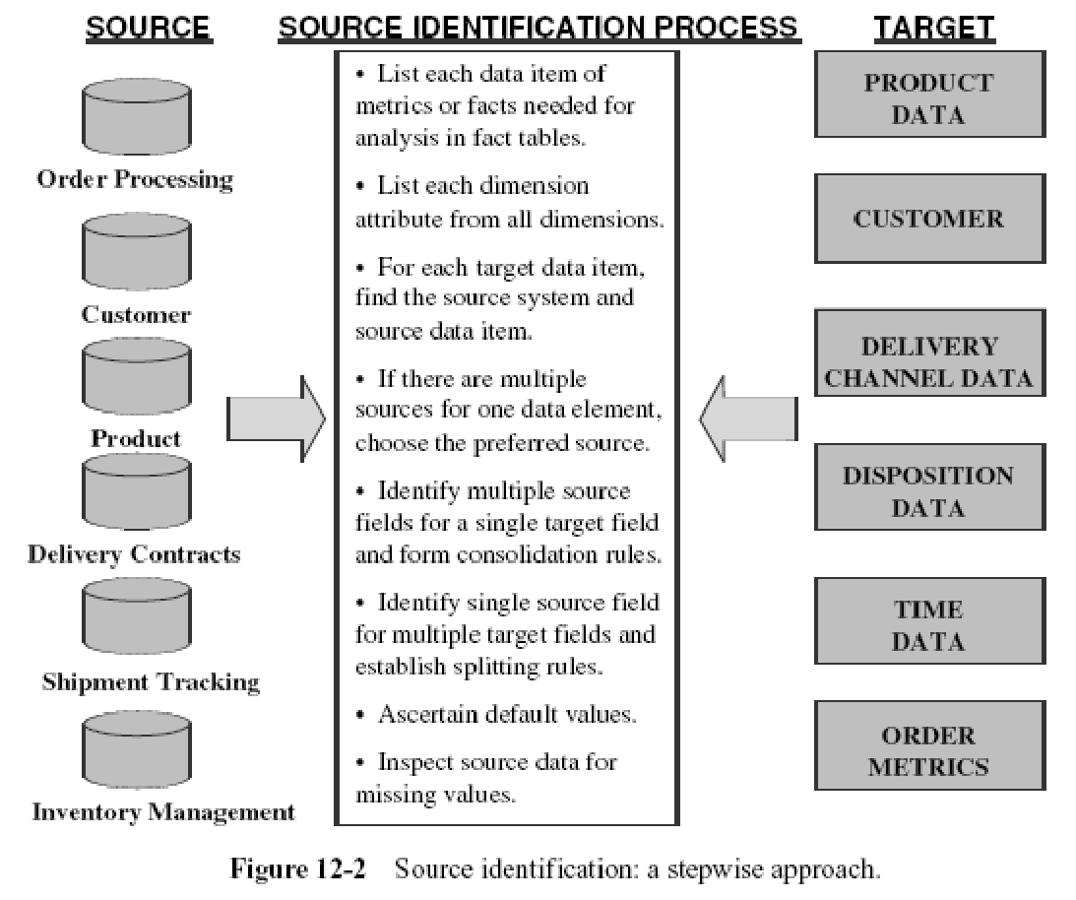

Slide 23
Data in Operational Systems.
Two categories:
Current Value. (most of the attributes) The value of an attribute remains constant only until a business transaction changes it. Data extraction for preserving the history of the changes in the data warehouse gets quite involved for this category of data.
Periodic Status. (not as common as the previous category) The history of the changes is preserved in the source systems themselves. Therefore, data extraction is relatively easier.

Slide 24
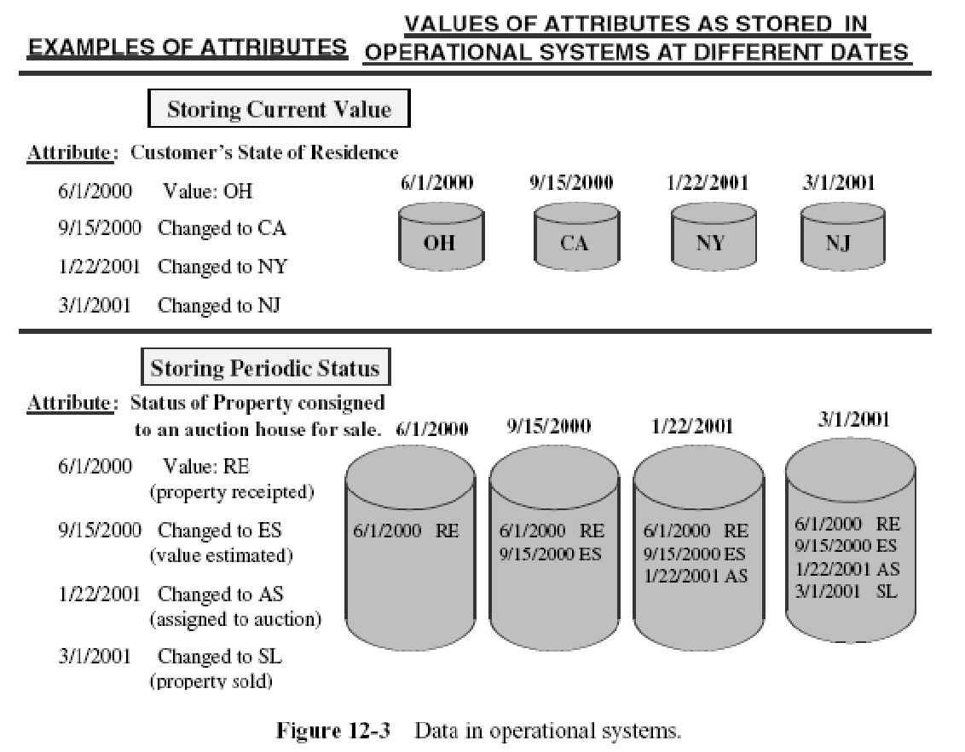

Slide 25
Data in Operational Systems.
When you deploy your data warehouse, the initial data as of a certain time must be moved to the data warehouse to get it started. This is the initial load.
After the initial load, your data warehouse must be kept updated so the history of the changes and statuses are reflected in the data warehouse. There are two major types of data extractions from the source operational systems:
“as is” (static) data
data of revisions.

Slide 26
Data in Operational Systems.
“As is” or static data is the capture of data at a given point in time.
It is like taking a snapshot of the relevant source data at a certain point in time.
Data of revisions is also known as incremental data capture.
Incremental data capture may be immediate or deferred.
Within the group of immediate data capture there are three distinct options.

Slide 27
Options for Data capture
Immediate Data Extraction.
Capture through Transaction Logs.
Capture through Database Triggers.
Capture in Source Applications.
Deferred Data Extraction.
Capture Based on Date and Time Stamp.
Capture by Comparing Files.

Slide 28
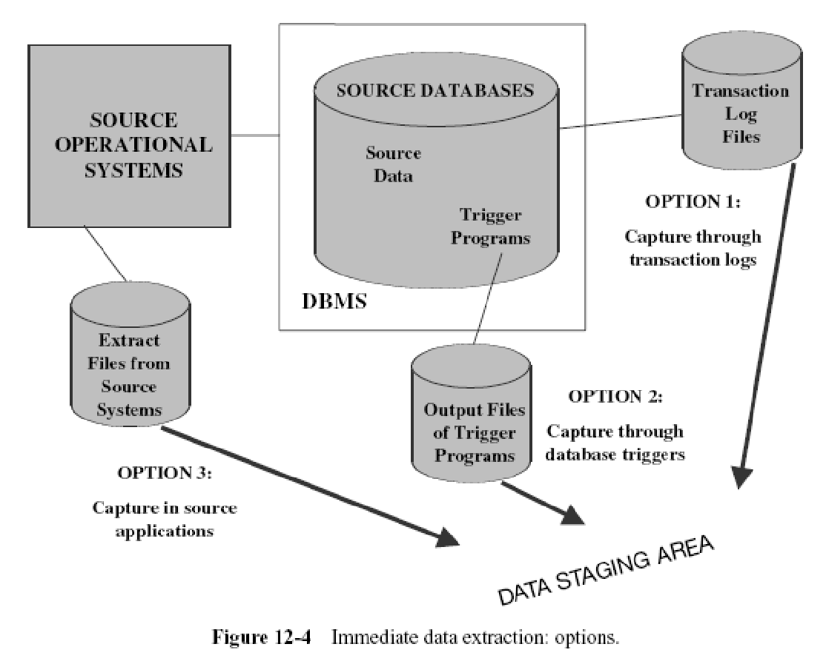

Slide 29
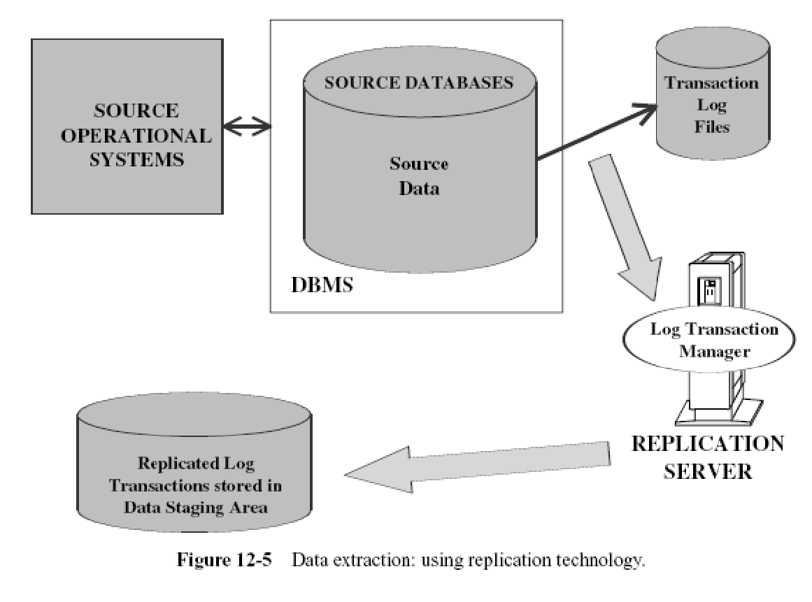

Slide 30
Data capture through database triggers
Data capture through database triggers occurs right at the source and is therefore quite reliable.
You can capture both before and after images.
Building and maintaining trigger programs puts an additional burden on the development effort.
Execution of trigger procedures during transaction processing of the source systems puts additional overhead on the source systems.
This option is applicable only for source data in databases.

Slide 31
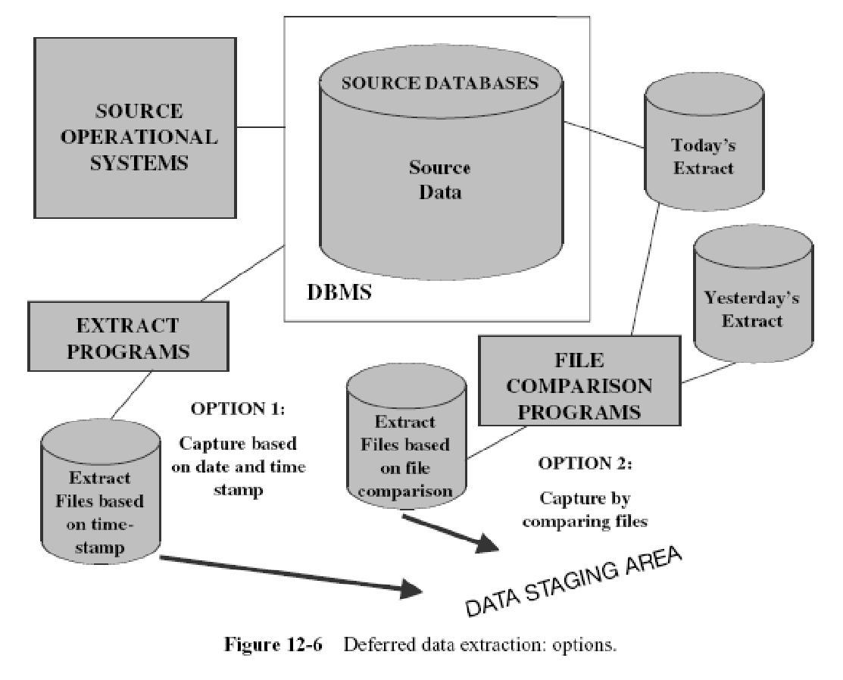

Slide 32
Capture Based on Date and Time Stamp
Deletion of source records presents a special problem. If a source record gets deleted in between two extract runs, the information about the delete is not detected.
You can get around this by marking the source record for delete first, do the extraction run, and then go ahead and physically delete the record.
This means you have to add more logic to the source applications.

Slide 33
Capture by Comparing Files
If none of the above techniques are feasible for specific source files in your environment, then consider this technique as the last resort.
This technique is also called the snapshot differential technique because it compares two snapshots of the source data.

Slide 34
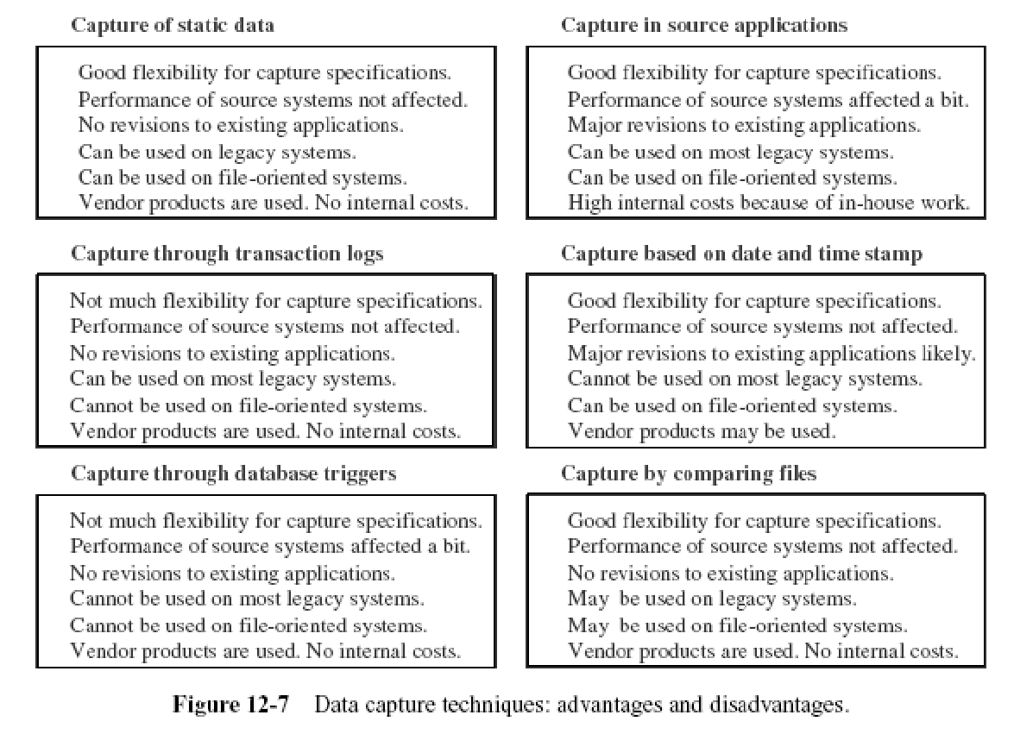

Slide 35
Extraction Methods in Data Warehouses
Logical Extraction Methods
There are two kinds of logical extraction:
Full Extraction
Incremental Extraction
Physical Extraction Methods
There are the following methods of physical extraction:
Online Extraction
Offline Extraction

Slide 36
Logical Extraction Methods
Full Extraction
The data is extracted completely from the source system.
This extraction reflects all the data currently available on the source system, there's no need to keep track of changes to the data source since the last successful extraction.
Source data will be provided as-is and no additional logical information (for example, timestamps) is necessary on the source site.
example : an export file of a distinct table or a remote SQL statement scanning the complete source table.

Slide 37
Incremental Extraction/Change data capture
At a specific point in time, only the data that has changed since a well-defined event back in history will be extracted.
This event may be the last time of extraction or a more complex business event like the last booking day
To identify this delta change there must be a possibility to identify all the changed information since this specific time event.

Slide 38
Continue…
1) This information can be either provided by the source data itself like an application column, reflecting the last-changed timestamp or a change table where an appropriate additional mechanism keeps track of the changes besides the originating transactions
2) entire tables from the source systems are extracted to the data warehouse or staging area, and these tables are compared with a previous extract from the source system to identify the changed data.
Disadv : No impact on the source systems, but it clearly can place a considerable burden on the data warehouse processes, particularly if the data volumes are large.

Slide 39
Physical Extraction Methods
Online Extraction
The data is extracted directly from the source system itself.
The extraction process can connect directly to the source system to access the source tables themselves or to an intermediate system that stores the data in a preconfigured manner (for example, snapshot logs or change tables).
Note that the intermediate system is not necessarily physically different from the source system.
With online extractions, you need to consider whether the distributed transactions are using original source objects or prepared source objects.

Slide 40
Offline Extraction
The data is not extracted directly from the source system but is staged explicitly outside the original source system.
The data already has an existing structure (for example, redo logs, archive logs or transportable table spaces) or was created by an extraction routine.
e.g. 1)Flat files : Data in a defined, generic format.
Additional information about the source object is
necessary for further processing.
2) Redo and archive logs
Information is in a special, additional dump file.

Slide 41
Transform

Slide 42
Data Transformation
Data transformations are often the most complex and, in terms of processing time, the most costly part of the ETL process.
They can range from simple data conversions to extremely complex data scrubbing techniques.
Improving the quality of data is major task in Data Transformation.

Slide 43
Data Transformation Tasks
Format revision e.g. field length, Data type
Decoding of fields e.g. gender, marital status,branch
Splitting of fields e.g. name, address
Merging of information eg personal info, medical info, educational info.
Character set conversion : EBCDIC , ASCII character
Conversion of units eg. Rs. , Euro, Takka --- $
Date and time conversion : US /British format
Summarization : datewise summarize the data e.g. sales
De-duplication : remove duplicate records

Slide 44
Transformation – a series of rules/functions.
Common Transformations are:
Convert data into a consistent, standardized form.
Cleanse(Automated)
Synonym Substitutions.
Spelling Corrections.
Encoding free-form values(map Male to 1 & Mr to M)
Merge/Purge(join data from multiple sources).
Aggregate(eg.rollup)
Calculate(sale_amt = qty * price)
Data type conversion
Data content audit
Null value handling(null = not to load)
Customized transformation(based on user).

Slide 45
Common Transformations..contd
Data type conversions
-EBCDIC ASCII/UniCode.
-String manipulations.
-Date/time format conversions.
-- E.g., unix time 1201928400 = what time?
Normalization/Denormalization
- To the desired DW format.
- Depending on source format.
Building keys
- Table matches production keys to surrogate DW keys.
- Correct handling of history - especially for total reload.

Slide 46
Data Transformation
3 major steps
- Data Cleansing
- Data Integration
- Other Transformations (includes replacement of codes, derived values, calculating aggregates)

Slide 47
Data Cleansing
Dirty Data
Dummy Values
Absence of Data
Cryptic Data
Contradicting Data
Inappropriate Use of Address Lines
Reused Primary Keys
Non-unique Identifiers

Slide 48
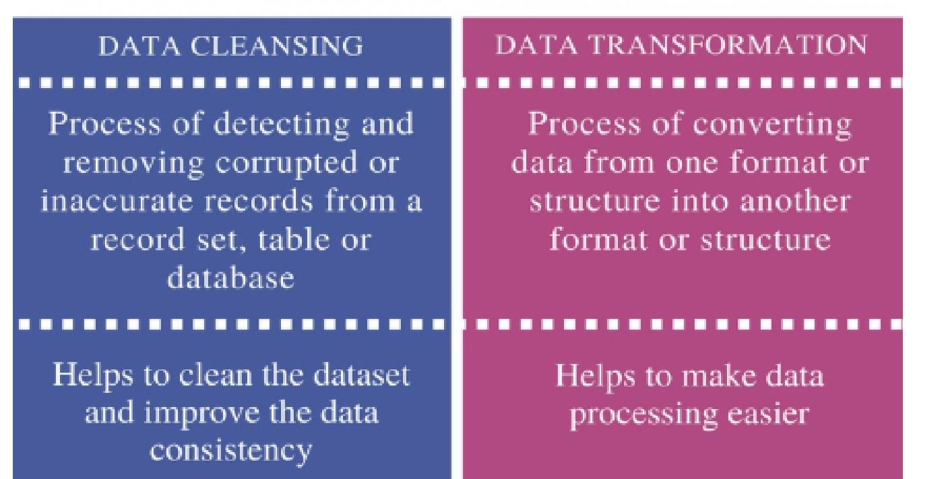
Data cleansing is the process of removing the unwanted data from a dataset or database.
Data transformation is the process of converting data from one format to another format.

Slide 49
Cleansing
Why cleansing? Garbage In Garbage Out.
BI does not work on “raw” data
- Pre-processing necessary for BI analysis.
Handle inconsistent data formats
- Spellings, codings, …
Remove unnecessary attributes
- Production keys, comments,…
Replace codes with text [for easy understanding]
- City name instead of ZIP code, e.g., Aalborg Centrum vs. DK-9000
Combine data from multiple sources with common key
- E.g., customer data from customer address, customer name, …

Slide 50
Cleansing
Don’t use “special” values (e.g., 0, -1) in your data.
-They are hard to understand in query/analysis operations.
Mark facts with Data Status dimension
- Normal, abnormal, outside bounds, impossible,…
- Facts can be taken in/out of analyses.
Uniform treatment of NULL
- Use NULLs only for measure values (estimates instead?)
- Use special dimension key (i.e., surrogate key value) for
NULL dimension values E.g., for the time dimension, instead of NULL, use special key values to represent “Date not known”, “Soon to happen”.
Avoid problems in joins, since NULL is not equal to NULL

Slide 51
Role of Data Transformation Process
Map the input data from the source systems to data for data warehouse repository.
Clean the data, fill all the missing values by some default value.
Remove duplicate records .
Perform splitting and merging of fields
Sort the records
De-normalize the extracted data according to the dimensional model of the DW.
Convert to appropriate data types.
Perform aggregation and summarizations

Slide 52
DATA LOADING
Data loading takes the prepared data, applies it to the data warehouse, and stores it in the database
Terminology:
Initial Load — populating all the data warehouse tables for the very first time
Incremental Load — applying ongoing changes as necessary in a periodic manner
Full Refresh — completely erasing the contents of one or more tables and reloading with fresh data (initial load is a refresh of all the tables)

Slide 53
Applying Data: Techniques and Processes
load,
append,
destructive
merge,
constructive merge.

Slide 54
Load
If the target table to be loaded already exists and data exists in the table, the load process wipes out the existing data and applies the data from the incoming file.
If the table is already empty before loading, the load process simply applies the data from the incoming file.

Slide 55
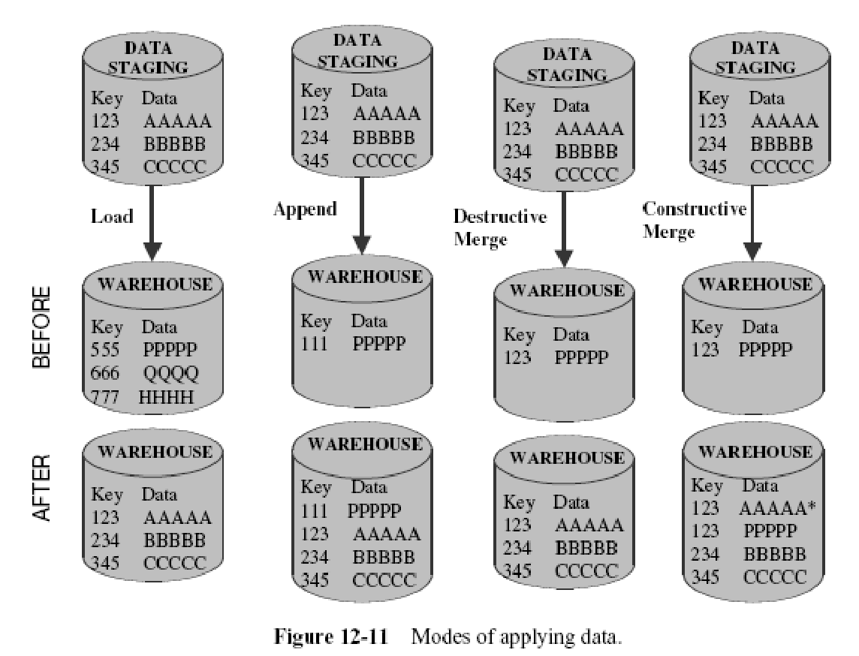

Slide 56
Append
extension of the load.
If data already exists in the table, the append process unconditionally adds the incoming data, preserving the existing data in the target table.
When an incoming record is a duplicate of an already existing record, you may define how to handle an incoming duplicate:
The incoming record may be allowed to be added as a duplicate.
In the other option, the incoming duplicate record may be rejected during the append process.

Slide 58
Destructive Merge
Applies incoming data to the target data.
If the primary key of an incoming record matches with the key of an existing record, update the matching target record.
If the incoming record is a new record without a match with any existing record, add the incoming record to the target table.

Slide 60
Constructive Merge
Slightly different from the destructive merge.
If the primary key of an incoming record matches with the key of an existing record, leave the existing record, add the incoming record, and mark the added record as superceding the old record.

Slide 62
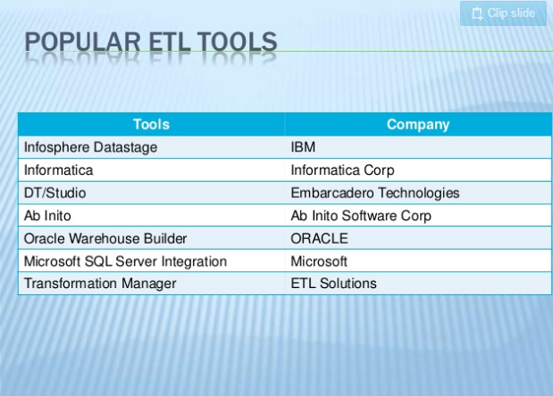

Slide 63
ETL Tools Options
Data transformation engines
Data capture through replication
Code generators

Slide 64
Loads
After extraction, cleaning and validation data need to oad into the warehouse
Issues
huge volumes of data to be loaded
small time window available when warehouse can be taken off line (usually nights)
when to build index and summary tables
allow system administrators to monitor, cancel, resume, change load rates
Recover gracefully -- restart after failure from where you were and without loss of data integrity

Slide 65
Load phrases
Load phrases
Initial Load : Load whole data / sub loads
Incremental Load : load the changes
Full Refresh : rewriting whole data warehouse

Slide 66
Load Techniques
Load
Append
Destructive merge
Constructive merge

Slide 67
Load Taxonomy
Incremental versus Full loads
Online versus Offline loads

Slide 68
Refresh
Propagate updates on source data to the warehouse
Issues:
when to refresh
how to refresh -- refresh techniques

Slide 69
When to Refresh?
periodically (e.g., every night, every week) or after significant events
on every update: not warranted unless warehouse data require current data (up to the minute stock quotes)
refresh policy set by administrator based on user needs and traffic
possibly different policies for different sources

Slide 70
Refresh Techniques
Full Extract from base tables
read entire source table: too expensive
maybe the only choice for legacy systems

Slide 71
Building Data Warehouse
Data Selection
Data Preprocessing
Fill missing values
Remove inconsistency
Data Transformation & Integration
Data Loading
Data in warehouse is stored in form of fact tables and dimension tables.

Slide 72
Case Study
Afco Foods & Beverages is a new company which produces dairy,bread and meat products with production unit located at Baroda.
There products are sold in North,North West and Western region of India.
They have sales units at Mumbai, Pune , Ahemdabad ,Delhi and Baroda.
The President of the company wants sales information.

Slide 73
Sales Information
Report: The number of units sold.
113
Report: The number of units sold over time
January | February | March | April
14 | 41 | 33 | 25

Slide 74
Sales Information
Report : The number of items sold for each product with
time
 | Jan | Feb | Mar | Apr
Wheat Bread |  |  | 6 | 17
Cheese | 6 | 16 | 6 | 8
Swiss Rolls | 8 | 25 | 21
Time
Product

Slide 75
Sales Information
Report: The number of items sold in each City for each product with time
 |  | Jan | Feb | Mar | Apr
Mumbai | Wheat Bread |  |  | 3 | 10
 | Cheese | 3 | 16 | 6
 | Swiss Rolls | 4 | 16 | 6
Pune | Wheat Bread |  |  | 3 | 7
 | Cheese | 3 |  |  | 8
 | Swiss Rolls | 4 | 9 | 15
City
Time
Product

Slide 76
Sales Information
Report: The number of items sold and income in each region for
each product with time.
 |  | Jan |  | Feb |  | Mar |  | Apr
 |  | Rs | U | Rs | U | Rs | U | Rs | U
Mumbai | Wheat Bread |  |  |  |  | 7.44 | 3 | 24.80 | 10
 | Cheese | 7.95 | 3 | 42.40 | 16 | 15.90 | 6
 | Swiss Rolls | 7.32 | 4 | 29.98 | 16 | 10.98 | 6
Pune | Wheat Bread |  |  |  |  | 7.44 | 3 | 17.36 | 7
 | Cheese | 7.95 | 3 |  |  |  |  | 21.20 | 8
 | Swiss Rolls | 7.32 | 4 | 16.47 | 9 | 27.45 | 15

Slide 77
Sales Measures & Dimensions
Measure – Units sold, Amount.
Dimensions – Product,Time,Region.

Slide 78
Sales Data Warehouse Model
Fact Table
City | Product | Month | Units | Rupees
Mumbai | Wheat Bread | January | 3 | 7.95
Mumbai | Cheese | January | 4 | 7.32
Pune | Wheat Bread | January | 3 | 7.95
Pune | Cheese | January | 4 | 7.32
Mumbai | Swiss Rolls | February | 16 | 42.40

Slide 79
Sales Data Warehouse Model
City_ID | Prod_ID | Month | Units | Rupees
1 | 589 | 1/1/1998 | 3 | 7.95
1 | 1218 | 1/1/1998 | 4 | 7.32
2 | 589 | 1/1/1998 | 3 | 7.95
2 | 1218 | 1/1/1998 | 4 | 7.32
1 | 589 | 2/1/1998 | 16 | 42.40

Slide 80
Sales Data Warehouse Model
Product Dimension Tables
Prod_ID | Product_Name | Product_Category_ID
589 | Wheat Bread | 1
590 | White Bread | 1
288 | Coconut Cookies | 2
Product_Category_Id | Product_Category
1 | Bread
2 | Cookies

Slide 81
Sales Data Warehouse Model
Region Dimension Table
City_ID | City | Region | Country
1 | Mumbai | West | India
2 | Pune | NorthWest | India

Slide 82
Sales Data Warehouse Model
Time
Sales Fact
Product
Product
Category
Region

Slide 83
ETL Testing Challenges:
ETL testing is quite different from conventional testing. There are many challenges we faced while performing data warehouse testing. Here is the list of few ETL testing challenges - Incompatible and duplicate data. - Loss of data during ETL process. - Unavailability of inclusive test bed. - Testers have no privileges to execute ETL jobs by their own. - Volume and complexity of data is very huge. - Fault in business process and procedures. - Trouble acquiring and building test data. - Missing business flow information.

Slide 84
ETL Tools
From big vendors :
-Oracle Warehouse Builder
-IBM DB2 Warehouse Manager
-Microsoft Integration Services

